Slide 1
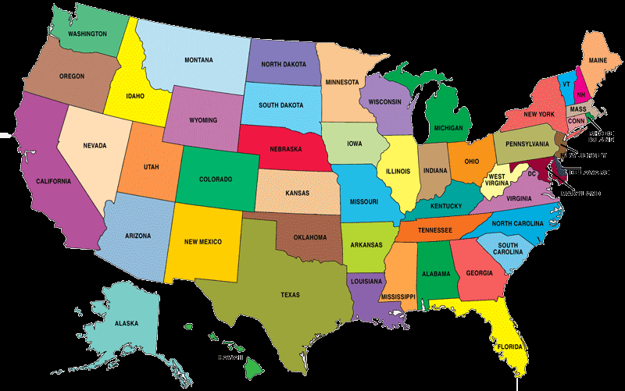
States and Capitals

Slide 2
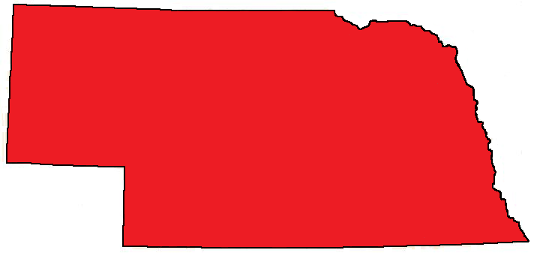
What is the capital of nebraska?
a. Lincoln b. Grand Island c. Omaha

Slide 3
Yes, Lincoln is the capitol of Nebraska!
NEXT

Slide 4
Try again!

Slide 5
WHAT IS THE CAPITAL OF IOWA?
a. Des Moines b. Council Bluffs c. Ames

Slide 6
Yes, Des Moines is the capital of Iowa!

Slide 7
Try again!

